Slide 1
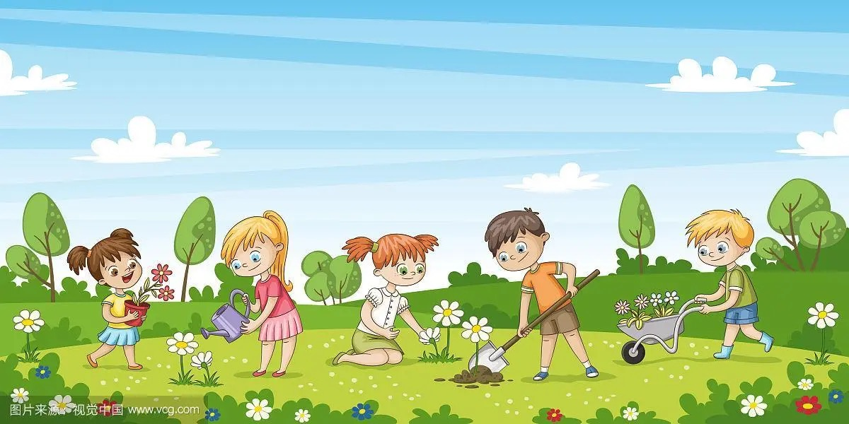
World of Plants
植物世界

Slide 2
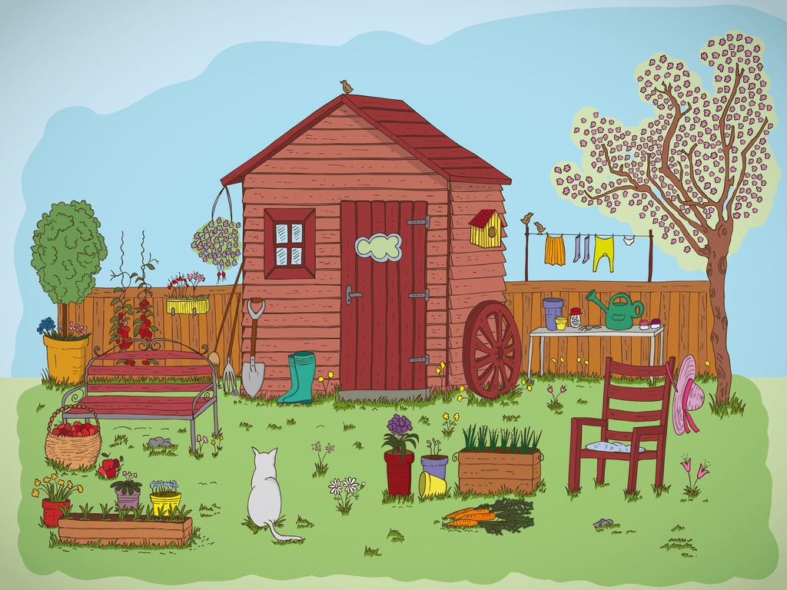
What can you see？
trees
watering can
potted plants
farm tools
fruits
trees
flowers
vegetables
grass

Slide 3
What can’t you see？
sunshine
temperature
air
soil
water
insects

Slide 4
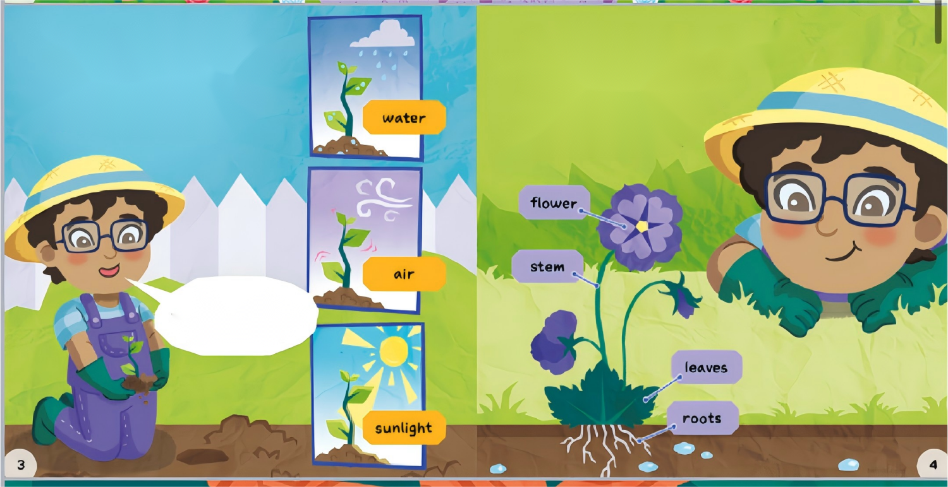
What ls a Plant?
Plants are living things. They need water and air to live. They also need enough space to grow.
植物是活着的东西，需要水和泥土去生存，还需要足够空间成长。
Parts of a Plant
Plants can all look very different. But they have lots in common. Most plants have flowers stems, leaves and roots.
植物经常长得不一样，但也有一样的，
例如植物多数有花、树叶、根茎。
Plants can make their own food using sunlight!
植物自己从阳光得到食物！

Slide 5
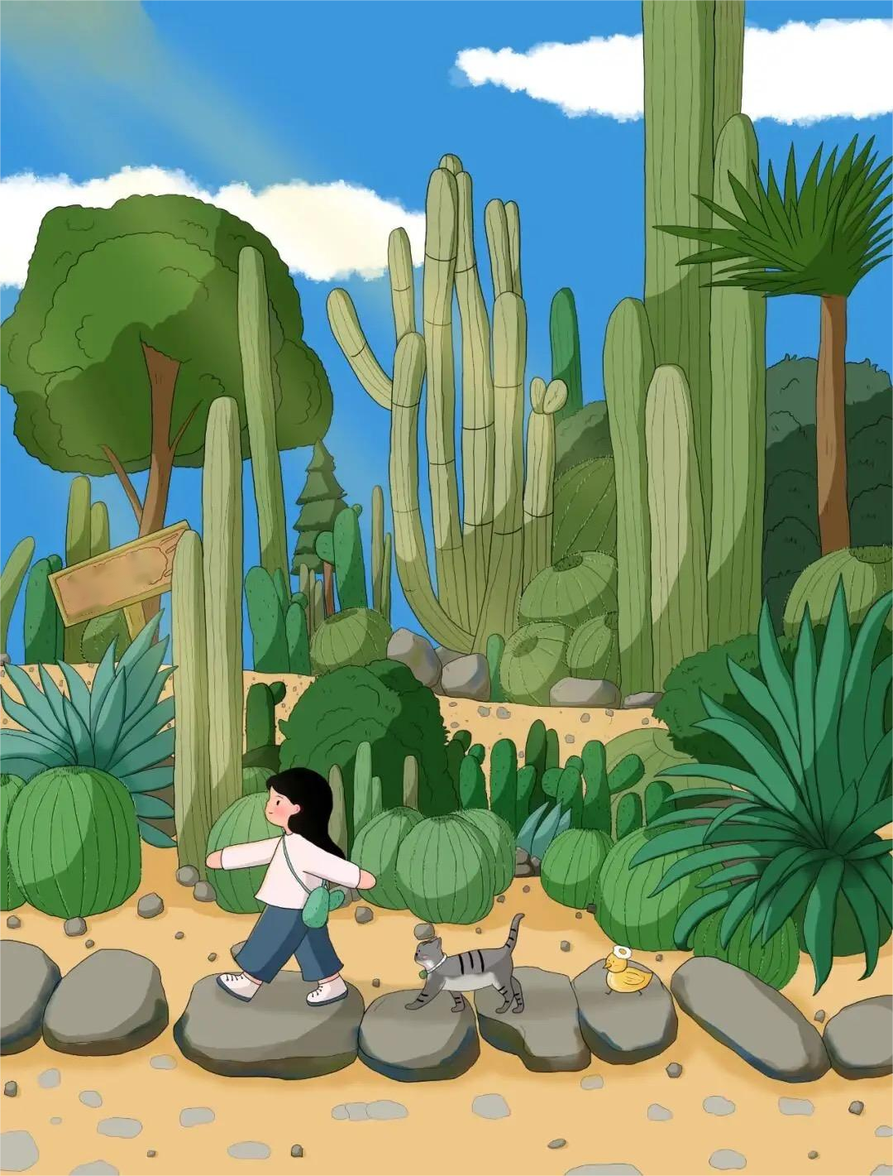
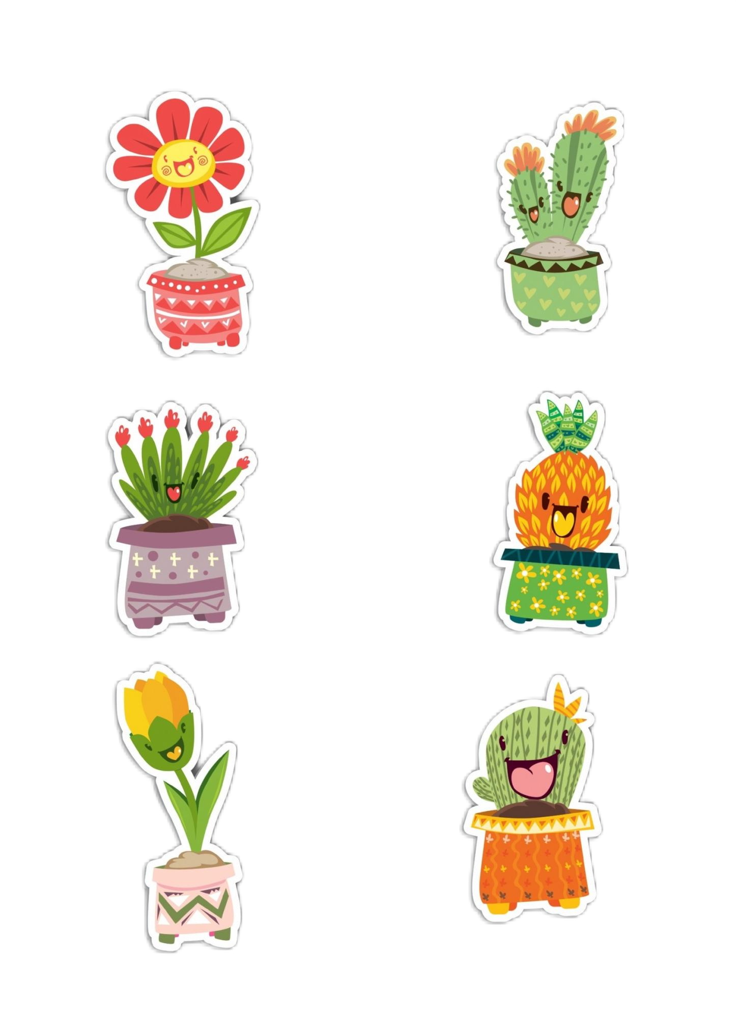
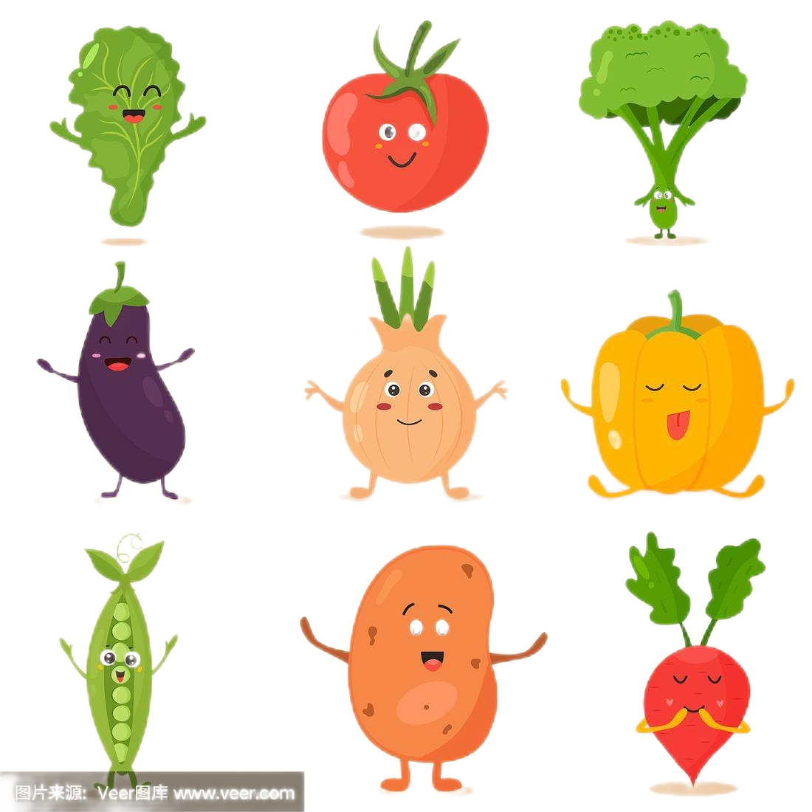
Garden
植物估计现存大约有350 000个物种！
There are about 350,000 species of plants in existence!
包括维持土地健康的树木、食用的蔬菜、观赏的花卉、制作药物的药草、生活中使用的木头和棉花，等等，其实都是植物。
Trees that maintain the health of the land, edible vegetables, ornamental flowers, herbs for making medicines, wood and cotton used in daily life, etc, are actually all plants.

Slide 6
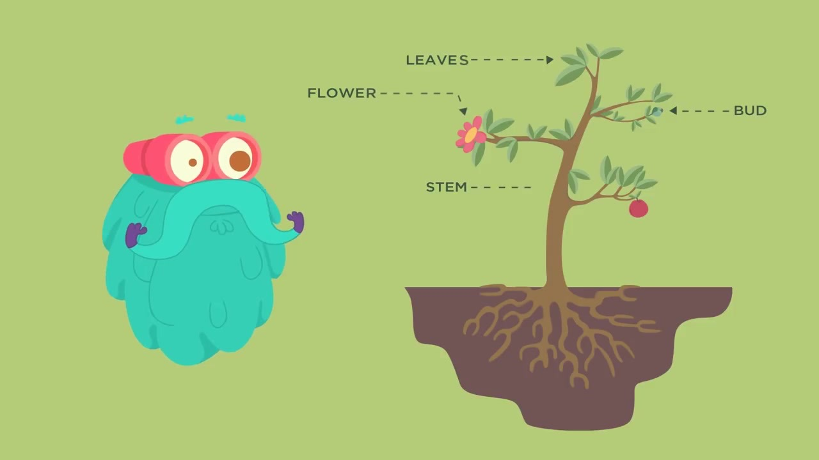
The six major organs of plants
植物的六大器官
叶子
花
/FRUIT
芽、果子
茎
- - - - - - - ROOT
？
根
SEED
种子

